Slide 1
Example search space
S
A
B
C
D
E
G

Slide 2
Example search space
start state
S
A
B
C
D
E
G
goal state

Slide 3
Example search space
start state
S
arc cost
1
8
5
A
B
C
3
9
7
4
5
D
E
G
goal state

Slide 4
Example search space
start state
0 _{S}
arc cost
1
8
5
1
A
5
B
8
C
3
7
8 E
9
4
5
g value (current)
4 D
9
G
goal state

Slide 5
Example search space
start state
0 _{S}
8
arc cost
1
8
5
1
A
5
B
4
8
C
8
3
3
7
8 E
9
h value g value (current)
4
5
4 D
∞
9
G
∞
0
goal state

Slide 6
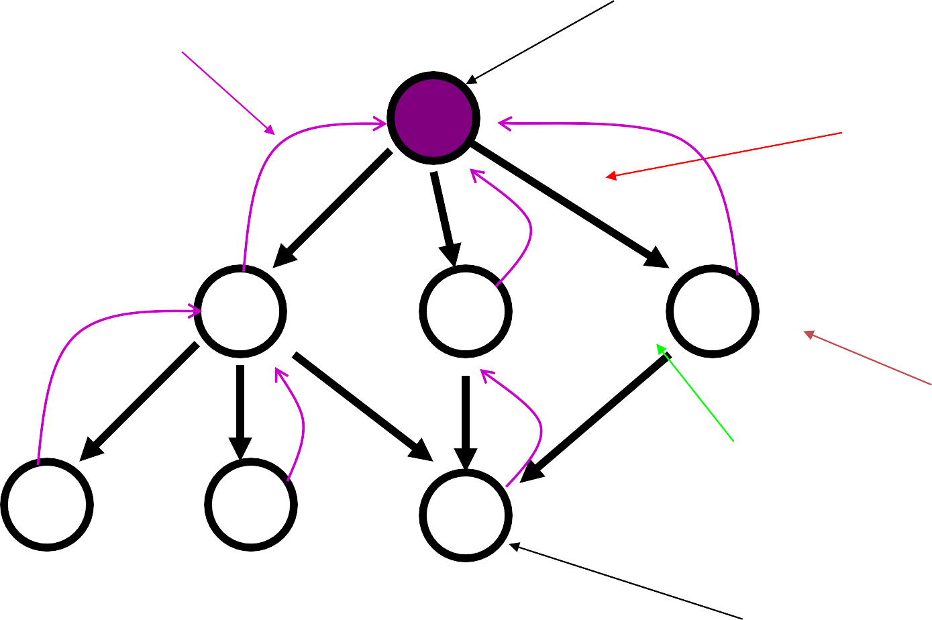
Example search space
start state
parent pointer (current)
0 _{S}
8
arc cost
1
8
5
1
A
5
B
4
8
C
3
8
3
7
8 E
9
h value g value (current)
4
5
4 D
∞
∞
9
G
0
goal state

Slide 7
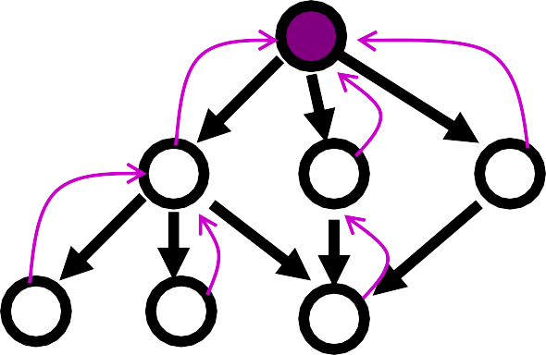
Example
0
_{S} 8
5
B 4
1
8
1
A
8
5
8
C
3
3
9
7
4
5
4
D
∞
8
E
∞
9
G
0
n | g(n) | h(n) | f(n) | h*(n)
S | 0 | 8 | 8 | 9
h*(n) is (hypothetical) perfect heuristic (an oracle)
Since h(n) <= h*(n) for all n, h is admissible (optimal)
Optimal path = S B G with cost 9

Slide 8
Example
0
_{S} 8
5
B 4
1
8
1
A
8
5
8
C
3
3
9
7
4
5
4
D
∞
8
E
∞
9
G
0
n | g(n) | h(n) | f(n) | h*(n)
S | 0 | 8 | 8 | 9
A | 1 | 8 | 9 | 9
B | 5 | 4 | 9 | 4
C | 8 | 3 | 11 | 5
D | 4 | inf | inf | inf
E | 8 | inf | inf | inf
G | 9 | 0 | 9 | 0
h*(n) is (hypothetical) perfect heuristic (an oracle)
Since h(n) <= h*(n) for all n, h is admissible (optimal)
Optimal path = S B G with cost 9

Slide 9
0
_{S} 8
5
B 4
Greedy search
1
8
1
A
8
5
8
C
3
3
9
7
4
5
f(n) = h(n)
node expanded
4
D
∞
8
E
∞
9
G
0
nodes list
{ S(8) }
what’s next???

Slide 10
0
_{S} 8
5
B 4
Greedy search
1
8
1
A
8
5
8
C
3
3
9
7
4
5
f(n) = h(n)
4
D
∞
8
E
∞
9
G
0
node expanded |  | nodes | list
 | { | S(8) | }
S | { | C(3) | B(4) | A(8) | }
C | { | G(0) | B(4) | A(8) | }
G | { | B(4) | A(8) | }
Solution path found is S C G, 3 nodes expanded.
See how fast the search is!! But it is NOT optimal.

Slide 11
0
_{S} 8
5
B 4
A* search
1
8
1
A
8
5
8
C
3
3
9
f(n) = g(n) + h(n)
7
4
5
4
D
∞
8
E
∞
9
G
0
node exp.
nodes list
{ S(8) }
What’s next?

Slide 12
0
_{S} 8
5
B 4
A* search
1
8
1
A
8
5
8
C
3
3
9
f(n) = g(n) + h(n)
7
4
5
4
D
∞
8
E
∞
9
G
0
node exp.
nodes list
{ | S(8) | }
{ | A(9) | B(9) C(11) }
 |  | What’s next?
S

Slide 13
0
_{S} 8
5
B 4
A* search
1
8
1
A
8
5
8
C
3
3
9
f(n) = g(n) + h(n)
7
4
5
4
D
∞
8
E
∞
9
G
0
node exp.
nodes list
{ S(8) }
{ A(9) B(9) C(11) }
{ B(9) G(10) C(11) D(inf) E(inf) }
What’s next?
S A

Slide 14
0
_{S} 8
5
B 4
A* search
1
8
1
A
8
5
8
C
3
3
9
f(n) = g(n) + h(n)
7
4
5
4
D
∞
8
E
∞
9
G
0
node | exp. |  | nodes list
 |  | { | S(8) }
S |  | { | A(9) B(9) C(11) }
A |  | { | B(9) G(10) C(11) D(inf) | E(inf) | }
B |  | { | G(9) G(10) C(11) D(inf) | E(inf) | }
 |  |  | What’s next?

Slide 15
0
_{S} 8
5
B 4
A* search
1
8
1
A
8
5
8
C
3
3
9
f(n) = g(n) + h(n)
7
4
5
4
D
∞
8
E
∞
9
G
0
node | exp. |  | nodes list
 |  | { | S(8) }
S |  | { | A(9) B(9) C(11) }
A |  | { | B(9) G(10) C(11) D(inf) | E(inf) | }
B |  | { | G(9) G(10) C(11) D(inf) | E(inf) | }
G |  | { | C(11) D(inf) E(inf) }
Solution path found is S B G, 4 nodes expanded..
Still pretty fast. And optimal, too.

